Slide 1
UNIT I
Algorithm Analysis

Slide 2
Introduction to Algorithms

Slide 3
Algorithms
Algorithm: a method or a process followed to solve a problem.
An algorithm is a finite set of instructions that, if followed, accomplishes a particular task.
A recipe
Algorithm is a solution to a problem independent of programming language. It consist of set of finite steps which, when carried out for a given set of inputs, produce the corresponding output and terminate in a finite time.
An algorithm takes the input to a problem (function) and transforms it to the output.
A problem can have many algorithms.

Slide 4
Algorithm Properties
An algorithm possesses the following properties:
Input: zero or more quantities are externally supplied.
Output: at least one quantity is produced.
Definiteness: each instruction is clear and unambiguous.
Finiteness: if we trace out the instructions of an algorithm, then for all cases, the algorithm terminates after a finite number f steps.
Effectiveness: every instruction must be very basic so that it can be carried out, in principle, by a person using only pencil and paper.
Notes:
“Correct” means computes the proper function.
“Concrete steps” are executable by the machine in question.
We frequently interchange use of “algorithm” and “program” though they are actually different concepts.

Slide 5
Analysis of Algorithms

Slide 6
Analysis of Algorithms
Algorithm is a finite sequence of steps that the computer follows to solve a problem.
When you face with a problem, the first thing you need to do is to find out an algorithm to solve it.
Once you determine the algorithm to be correct, next step is to find out the resources (time and space) the algorithm will require. This is known as algorithm analysis.
Thus, an algorithm analysis measures the efficiency of the algorithm.
If your computer requires more resources than your computer has, it is useless.

Slide 7
What is efficiency?
Efficiency can be measured by time or space utilization by the algorithm.
An efficient algorithm is that which has
Small running time (Time complexity): The time taken by a program is the sum of the compiled time & the run time. The time complexity of an algorithm is given by the number of steps taken by the algorithm to compute the function it was written for.
Small space used (Space complexity): The space complexity of an algorithm is the amount of memory it needs to run.
We will consider only the time complexity.

Slide 8
What is good algorithm?
A good algorithm is like a sharp knife-it does exactly what it is supposed to do with a minimum amount of applied effort.

Slide 9
How to Measure Running Time of Algorithm?
Experimental study (run programs)
Growth function: Asymptotic Algorithm Analysis
Factors affecting running time
Speed: Speed of the machine running the program.
Language: Language in which the program was written. For example, programs written in assembly language generally run faster than those written in C or C++, which in turn tend to run faster than those written in Java.
Compiler: Efficiency of the compiler that created the program
The size of the input: processing 1000 records will take more time than processing 10 records.
Organization of the input: if the item we are searching for is at the top of the list, it will take less time to find it than if it is at the bottom.
Notes:
Empirical comparison is difficult to do “fairly” and is time consuming.
Critical resources: Time. Space (disk, RAM). Programmers effort. Ease of use (user’s effort).
Factors affecting running time: Machine load. OS. Compiler. Problem size. Specific input values for given problem size.
Approaching a value or curve arbitrarily closely (i.e., as some sort of limit is taken)

Slide 10
Experimental study
Write a program that implements the algorithm.
Run the program with data sets of varying size and composition.
Use a method to get an accurate measure of the actual running time.
Limitations of experimental studies
It is necessary to implement and test the algorithm in order to determine its running time.
Experiments can be done only on a limited set of inputs, and may not be indicative of the running time on other inputs not included in the experiment.
In order to compare two algorithms, the same hardware and software environments should be used.

Slide 11
Types of Algorithm analysis
Worst-case: (usually)
• T(n) = maximum time of algorithm on any input of size n.
Average-case: (sometimes)
• T(n) = expected time of algorithm over all inputs of size n.
• Need assumption of statistical distribution of inputs.
Best-case:
• Cheat with a slow algorithm that works fast on some input.

Slide 12
General Rules for Estimation
Simple statements: We assume that statement does not contain a function call. It takes a fixed amount to execute.
Sequence of simple statements: It takes an amount of execution time equal to the sum of execution times of individual statements.
Decision: For estimating the performance, then and else parts of the algorithm are considered independently. The performance estimate of the decision is taken to be the largest of the two individual.

Slide 13
General Rules for Estimation
Loops: The running time of a loop is at most the running time of the statements inside of that loop times the number of iterations.
Ex: for(i=0; i<N; i++)
This loop will run for N times.
Nested Loops: Running time of a nested loop containing a statement in the inner most loop is the running time of statement multiplied by the product of the sized of all loops.
Ex:
for (i=0; i< N; i++) {
for (j=0; j< N; i++) {
sequence of simple statements
}}
This loop will run for N*N times.

Slide 14
General Rules for Estimation
1. Nested loops are multiplied together. 2. Sequential loops are added. 3. Only the largest term is kept, all others are dropped. 4. Constants are dropped. 5. Conditional checks are constant (i.e. 1).

Slide 15
The Running Time of Algorithms
Each operation in an algorithm (or a program) has a cost.
➔ Each operation takes a certain of time.
count = count + 1; ➔ take a certain amount of time, but it is constant
A sequence of operations:
count = count + 1; Cost: c₁
sum = sum + count; Cost: c₂
➔ Total Cost = c₁ + c₂

Slide 16
The Running Time of Algorithms (cont.)
Example: Simple If-Statement
Cost Times
if (n < 0) c1 1
absval = -n c2 1
else
absval = n; c3 1
Total Cost <= c1 + max(c2,c3)

Slide 17
The Running Time of Algorithms (cont.)
Example: Simple Loop
Cost Times
i = 1; c1 1
sum = 0; c2 1
while (i <= n) { c3 n+1
i = i + 1; c4 n
sum = sum + i; c5 n
}
Total Cost = c1 + c2 + (n+1)*c3 + n*c4 + n*c5
➔ The time required for this algorithm is proportional to n

Slide 18
The Running Time of Algorithms (cont.)
Example: Nested Loop
Cost Times
i=1; c1 1
sum = 0; c2 1
while (i <= n) { c3 n+1
j=1; c4 n
while (j <= n) { c5 n*(n+1)
sum = sum + i; c6 n*n
j = j + 1; c7 n*n
}
i = i +1; c8 n
}
Total Cost = c1 + c2 + (n+1)*c3 + n*c4 + n*(n+1)*c5+n*n*c6+n*n*c7+n*c8
➔ The time required for this algorithm is proportional to n²

Slide 19
Growth function
It is also possible to predict the performance by looking at the growth rate of an algorithm.
It is known that the running time of the algorithm is a function of the input size such as the number of elements in an array.
The amount of time that any algorithm takes to run depends on the amount of input it must process.
Ex. Sorting an array of 10000 elements require more processing time than sorting an array of 100 elements.

Slide 20
Eight Growth Functions
Eight functions O(n) that occur frequently in the analysis of algorithms (in order of increasing rate of growth relative to n):
Constant ≈ 1
Logarithmic ≈ log n
Linear ≈ n
Log Linear ≈ n log n
Quadratic ≈ n²
Cubic ≈ n³
Exponential ≈ 2^{n}
Exhaustive Search ≈ n!

Slide 21
Growth Rates Compared
 | n=1 | n=2 | n=4 | n=8 | n=16 | n=32
1 | 1 | 1 | 1 | 1 | 1 | 1
logn | 0 | 1 | 2 | 3 | 4 | 5
n | 1 | 2 | 4 | 8 | 16 | 32
nlogn | 0 | 2 | 8 | 24 | 64 | 160
n² | 1 | 4 | 16 | 64 | 256 | 1024
n³ | 1 | 8 | 64 | 512 | 4096 | 32768
2^{n} | 2 | 4 | 16 | 256 | 65536 | 4294967296
n! | 1 | 2 | 24 | 40320 | 20.9T | Don’t ask!

Slide 22
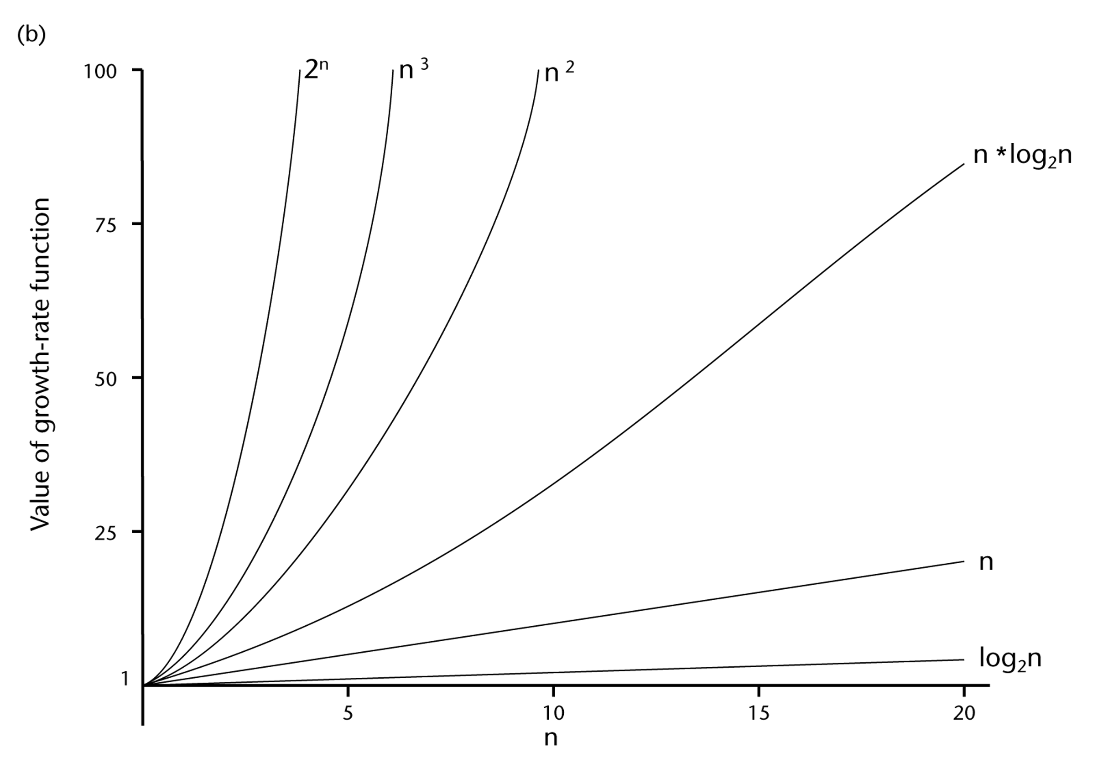
A Comparison of Growth-Rate Functions (cont.)

Slide 23
Some Mathematical Facts
Some mathematical equalities are:

Slide 24
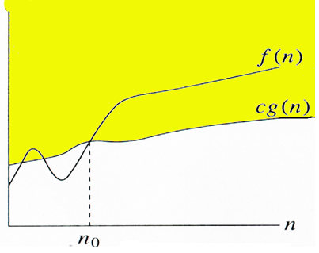
Asymptotic Analysis
To compare two algorithms with running times f(n) and g(n), we need a rough measure that characterizes how fast each function grows.
If after a certain point say n_{o} ,one of the function is definitely better than the other, then we can say that f(n) is greater than g(n) asymptotically.

Slide 25
Asymptotic Notation
O notation (Worst Case): asymptotic “less than” or asymptotic upper bound
f(n)=O(g(n)) implies: f(n) “≤” g(n)
2. Ω notation (Best Case): asymptotic “greater than” or asymptotic lower bound
f(n)= Ω (g(n)) implies: f(n) “≥” g(n)
3. Θ notation (Average Case): asymptotic “equality” or asymptotic tight bound
f(n)= Θ (g(n)) implies: f(n) “=” g(n)

Slide 26
Big O Notation
Since the capital O is used in the notation, this notation is called the Big O notation.
Big O is the method of expressing the upper bound of an algorithm’s running time.
It measures the longest amount of time it could possibly take for the algorithm to complete.
Thus, we can say that it finds the asymptotic upper bound.

Slide 27
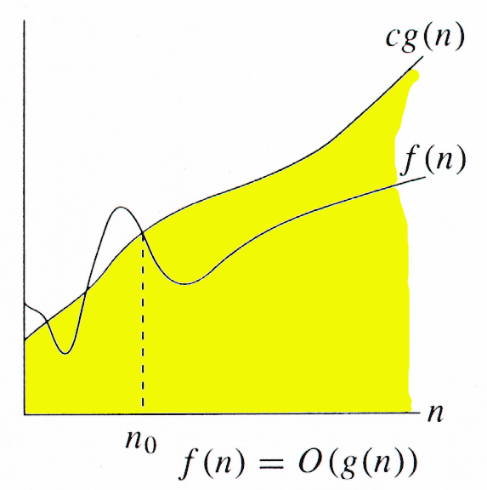
O-notation
A function f(n)=O(g(n)) if ∃ positive constants c and n_{0,} such that ∀n ≥ n₀,
we have 0 ≤ f(n) ≤ cg(n) }

Slide 28
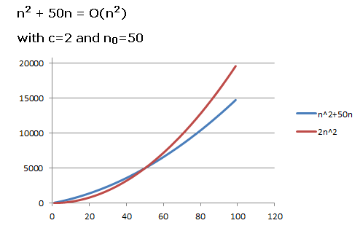
Examples
If f(n)= n ² +50n and g(n)=2n ²
Prove that f(n)=O(g(n)) or f(n) is upper bounded by g(n).

Slide 29
Ω -notation
It represents lower bound for a function.
It is the method of expressing the lower bound of an algorithm’s running time.
It measures the minimum amount of time it could possibly take for the algorithm to complete.
Thus, we can say that it finds the asymptotic lower bound.

Slide 30
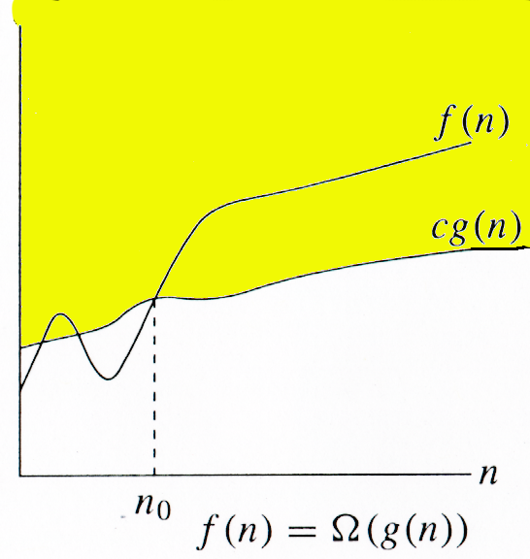
Ω -notation
A function f(n)=Ω(g(n)) ∃ positive constants c and n_{0,} such that ∀n ≥ n₀,
we have 0 ≤ cg(n) ≤ f(n)}

Slide 31
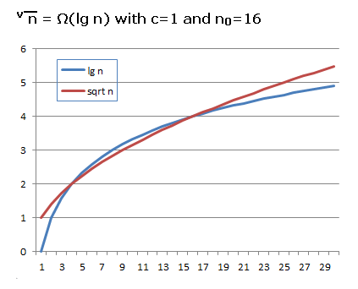
Example
If f(n)= √n and g(n)= lg n
Prove that f(n)= Ω(g(n)) or f(n) is lower bounded by g(n).

Slide 32
Θ -notation
Theta notation is used when function f(n) can be bounded both from above and below by the same function g(n).

Slide 33
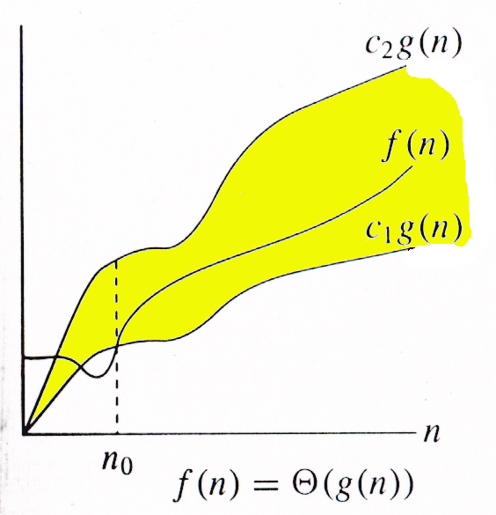
Θ-notation
A function f(n)=Θ(g(n)) ∃ positive constants c₁, c₂, and n_{0,} such that ∀n ≥ n₀,
we have 0 ≤ c₁g(n) ≤ f(n) ≤ c₂g(n)

Slide 34
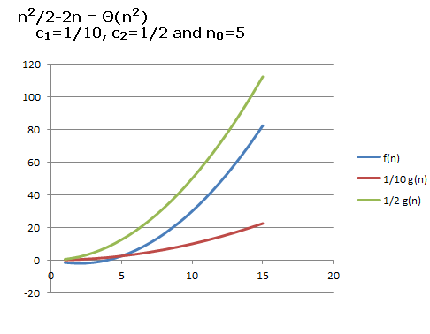
Example
f(n)=n²/2-2n
g(n)=n²
Show that 0 ≤ c₁g(n) ≤ f(n) ≤ c₂g(n)
c₁=1/10, c₂=1/2 and n₀=5

Slide 35
Relations Between Θ,Ω, O

Slide 36
Growth-Rate Functions – Example1
Cost Times
i = 1; c1 1
sum = 0; c2 1
while (i <= n) { c3 n+1
i = i + 1; c4 n
sum = sum + i; c5 n
}
T(n) = c1 + c2 + (n+1)*c3 + n*c4 + n*c5
= (c3+c4+c5)*n + (c1+c2+c3)
= a*n + b
➔ So, the growth-rate function for this algorithm is O(n)

Slide 37
Growth-Rate Functions – Example2
Cost Times
i=1; c1 1
sum = 0; c2 1
while (i <= n) { c3 n+1
j=1; c4 n
while (j <= n) { c5 n*(n+1)
sum = sum + i; c6 n*n
j = j + 1; c7 n*n
}
i = i +1; c8 n
}
T(n) = c1 + c2 + (n+1)*c3 + n*c4 + n*(n+1)*c5+n*n*c6+n*n*c7+n*c8
= (c5+c6+c7)*n² + (c3+c4+c5+c8)*n + (c1+c2+c3)
= a*n² + b*n + c
➔ So, the growth-rate function for this algorithm is O(n²)

Slide 38
Growth-Rate Functions – Example3
Cost Times
for (i=1; i<=n; i++) c1 n+1
for (j=1; j<=i; j++) c2
for (k=1; k<=j; k++) c3
x=x+1; c4
T(n) = c1*(n+1) + c2*( ) + c3* ( ) + c4*( )
= a*n³ + b*n² + c*n + d
➔ So, the growth-rate function for this algorithm is O(n³)

